Slide 1

Fake Currency Detection Using Python Flask
SDM Institute of Technology, Ujire Department of Information Science and Engineering
Mini Project(BIS586)
A Presentation on
Presented By
Amit U Pai-4SU22IS004
Ashwal T S-4SU22IS007
Giridhara M-4SU22IS018
Mahesh M B-4SU22IS028
Shantakumar-4SU22IS041
Under the Guidance of
Mrs. Ashwini B
Assistant professor

Slide 2
Agenda
Introduction
Literature Survey
Problem Statement
System Requirements
Objectives
Methodology
System Design
Implementation
Excepted outcomes
Conclusion

Slide 3
Introduction
Develop a Python Flask application to identify counterfeit currency through image processing.
Utilize image analysis techniques to detect features of genuine currency notes and coins.
Implement a user-friendly interface for uploading and verifying currency images.
Integrating with Machiene Learning Model.

Slide 4
Literature Survey
Name of research paper: | Fake Currency Detection Process
Year: | 2019
Authors: | T Naveen Kumar, T Subhash
Key Point: | The study presents an approach to detect counterfeit currency using advanced image processing techniques such as edge detection and texture analysis.
Summary Of Abstract: | It proposes a cost-effective and efficient digital solution for detecting fake currency by analyzing distinguishing features of authentic notes.
Plus Point: | Utilizes a combination of image processing and machine learning for robust detection.
Research Gap: | Limited exploration of performance with varying environmental conditions like poor lighting or blurred images.

Slide 5
Literature Survey
Name of research paper: | Fake Currency Detection Using Image Processing
Year: | 2019
Authors: | Vidhi Roy, Gangey Mishra
Key Point: | The paper employs image processing techniques such as edge detection, texture analysis, and color feature extraction to distinguish between fake and genuine currency.
Summary Of Abstract: | The research focuses on identifying counterfeit currency through advanced image processing techniques. It highlights the effectiveness of these methods in achieving reliable and accurate detection.
Plus Point: | The study provides a cost-effective, automated solution that does not rely on specialized hardware.
Research Gap: | Limited discussion on handling degraded or blurred currency images, which are common in real-world scenarios.

Slide 6
Literature Survey
Name of research paper: | Research on Fake Indian Currency Note Detection using ImageProcessing
Year: | 2021
Author: | Miss.I. Santhiya Irulappasamy
Key Point: | It employs software-based approaches, emphasizing texture and security feature analysis for classification between genuine and fake currency.
Summary Of Abstract: | The research highlights the development of an efficient, software-based system for detecting counterfeit Indian currency notes using image processing techniques.
Plus Point: | The proposed model offers high accuracy and efficiency through advanced feature extraction algorithms, potentially reducing manual errors.
Research Gap: | The study lacks consideration of real-world challenges like blurred or partially visible images of currency notes.

Slide 7
Literature Survey
Name of research paper: | A review of Fake Currency Recognition Methods
Year: | 2022
Author: | Sruthy R
Key Point: | The study highlights the use of edge detection algorithms, such as Canny edge detection, for identifying counterfeit currency. This approach achieves an accuracy of approximately 90.45%.
Summary Of Abstract: | The paper reviews various methods for counterfeit currency detection, focusing on image processing and machine learning approaches.
Plus Point: | The proposed techniques reduce reliance on expensive hardware and improve accessibility for regular users.
Research Gap: | Current models are often designed for specific currencies, limiting their applicability across different regions or note designs.

Slide 8
Literature Survey
Name of research paper: | Detection of Fake Currency Using Machine Learning Models
Year: | 2024
Authors: | Dr. Sarangam Kodati, Dr. M. Dhasaratham
Key Point: | The study focuses on detecting fake currency using machine learning algorithms such as K-Nearest Neighbors (KNN) and Support Vector Machines (SVM), achieving high accuracy through advanced image processing techniques like wavelet transforms and feature extraction.
Summary Of Abstract: | It highlights KNN as particularly effective for small datasets, achieving high precision and reliability in identifying fake notes.
Plus Point: | The study achieves remarkable accuracy (99.9%) using straightforward yet robust techniques like KNN and SVM, making it accessible for real-world applications.
Research Gap: | The dataset used is relatively small and captured under controlled conditions, which may not fully represent real-world scenarios with varied lighting, wear, and tear.

Slide 9
Problem Statement
Currency Image Verification
ML Model Integration
Optical Feature Extraction
Automated Pattern Recognition

Slide 10
System Requirements
Software Requirements:
Hardware Requirements:
Programming Language: Python
Framework:Flask
Libraries for Image Processing:OpenCV
Frontend Tools:HTML and CSS
Pre-trained Model:scikit-image
I7 Processor:1.90 GHz
Installed RAM:16.0 GB

Slide 11
Objectives
Detecting fake currency from various countries without internet access.
Implement image processing techniques to analyze and validate currency notes.
Incorporate functionality to accept and process blurred images for detection.
Create a user-friendly interface for uploading images and displaying results.

Slide 12
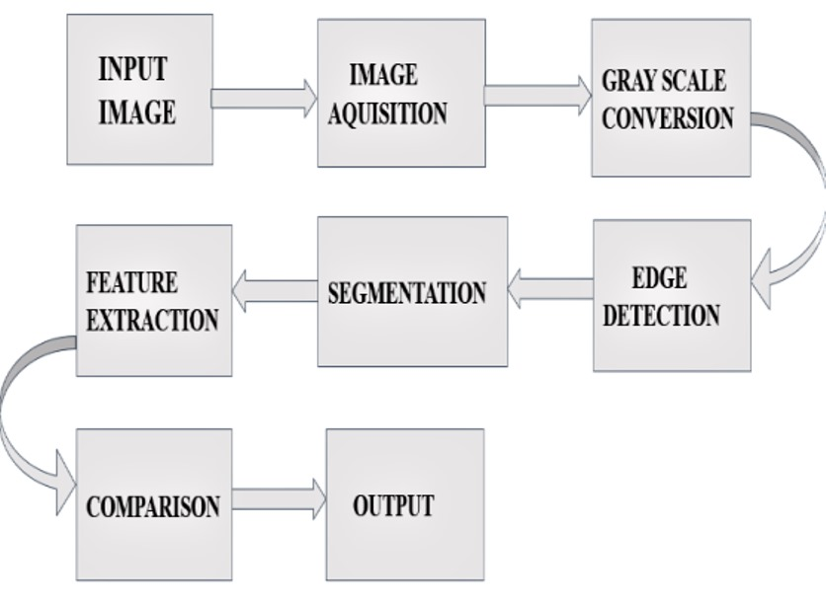
Methodology

Slide 13
System Design
Upload Images
Extract Features
Predict and Generate Report
Show result

Slide 14
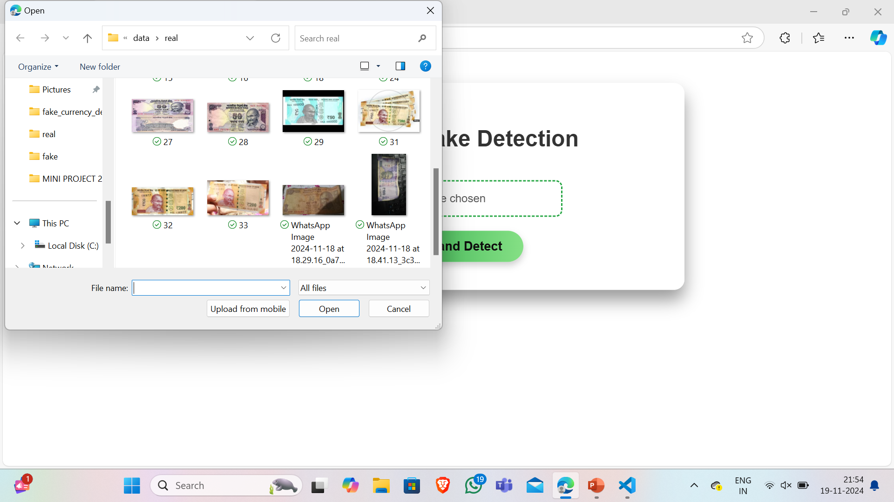
Set Of Inputs

Slide 15
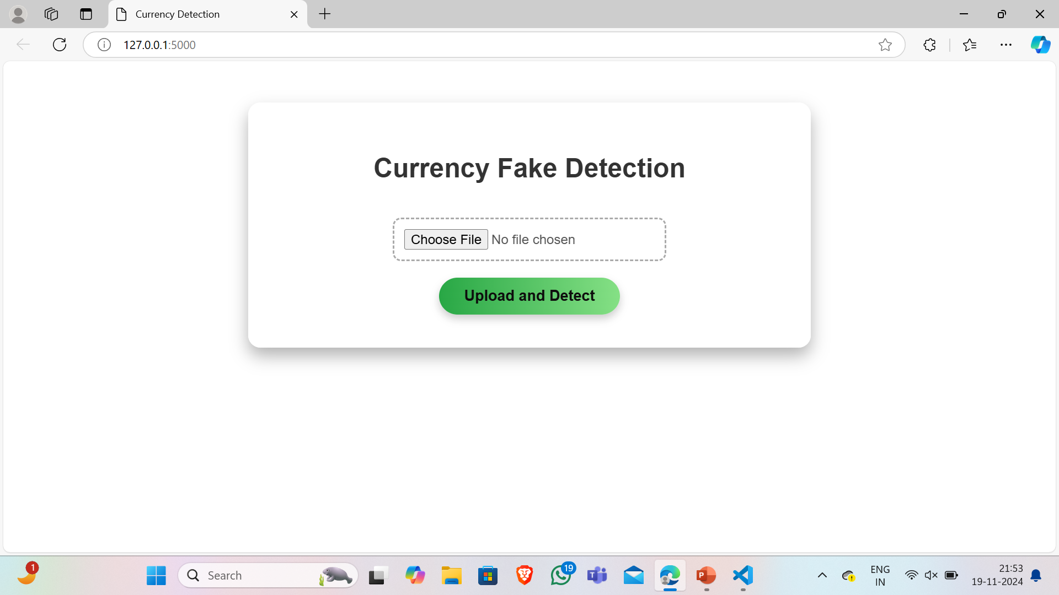
Implementation

Slide 16
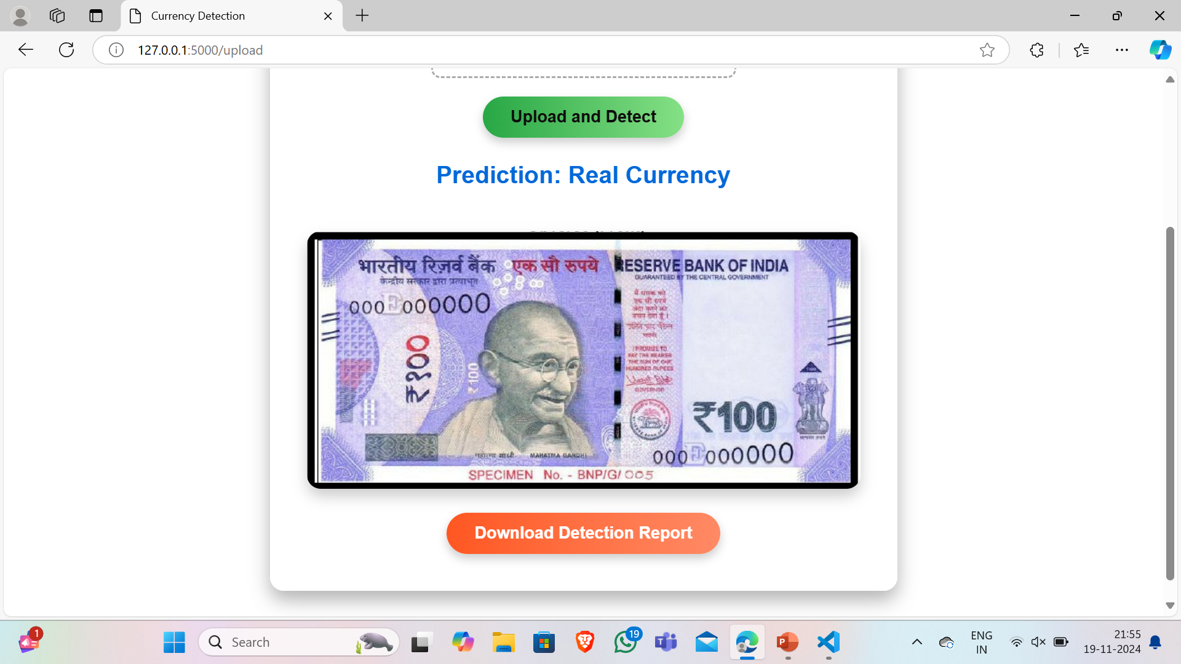
Implementation

Slide 17
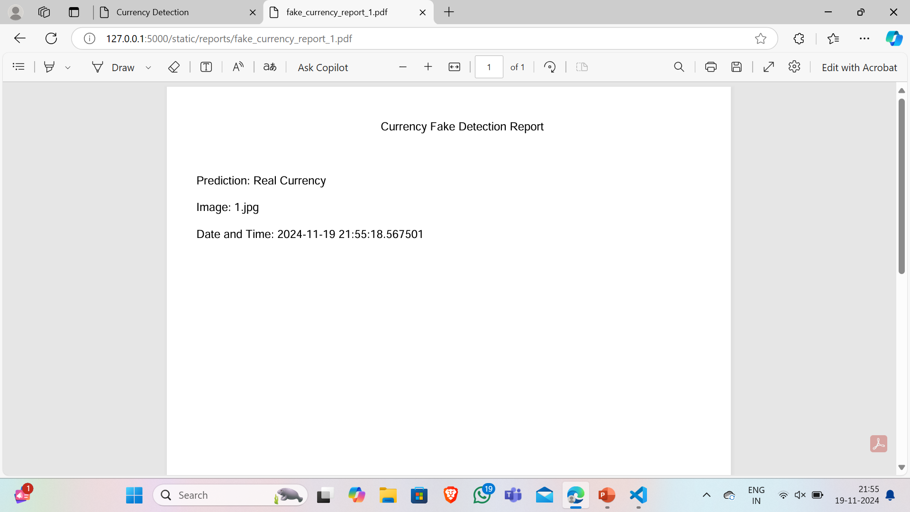
Implementation

Slide 18
Expected Outcomes
Detects fake currency notes and coins across multiple countries
Identifies counterfeit features without internet or external hardware
Uses local image processing to classify currencies
Logs the location of the detected fake currency for tracking

Slide 19
Conclusion
Successfully implemented image preprocessing, feature extraction, and note validation with 70% functional output.
Remaining tasks include enhancing the system for coin detection capabilities.
Live location integration and automated report generation are under development.
On track to deliver a comprehensive fake currency detection solution using Python and Flask.

Slide 20
14. ‘Thank You’ Slide (1 slide)
Just mention ‘THANK YOU’ on this slide.
Include ‘QUESTIONS?’ If you want.
THANK YOU

